Slide 1
Cooperation Systems – Final presentation Visual augmented reality manual support
A. Droste, A. Machmer, A. Mantel, J. Schwede
Department for computer science
7th of February 2019

Slide 2
Our cooperation system (1/3) – idea
AR support for the collaborative usage of (operation) manuals
e.g. build your furniture together with additional complementary information
Supporting through Augmented Reality
Different roles possible but not necessary
“Searcher”
“Builder”

Slide 3
Our cooperation system (2/3) – goals
Simplify and improve the building process (failures, speed)
Is AR support for manuals useful?
Do users accept this kind of support?
Do they want this support?
Can AR support the users with their task in this context?
-> Target of our evaluation

Slide 4
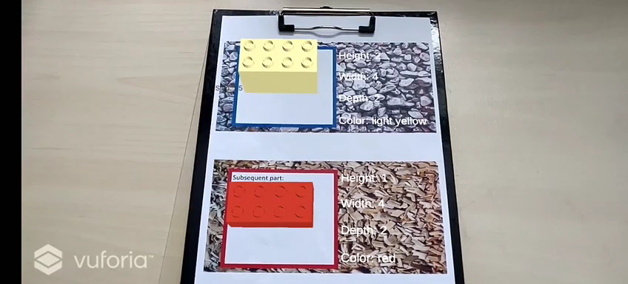
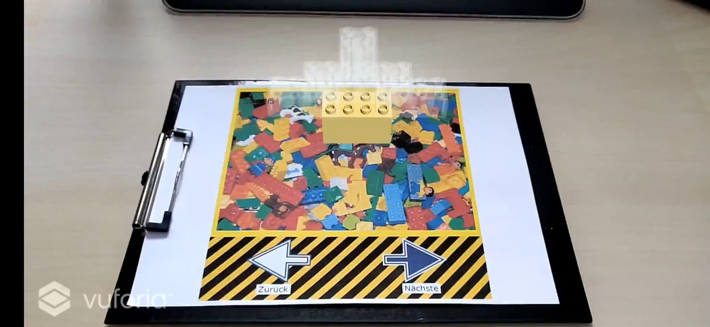

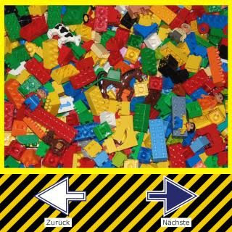
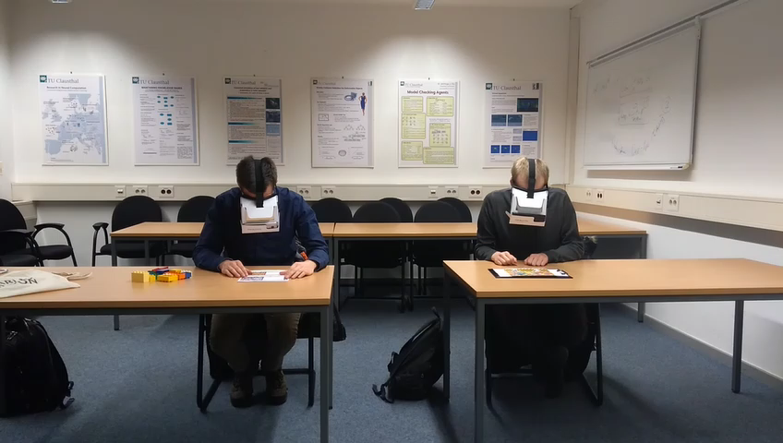
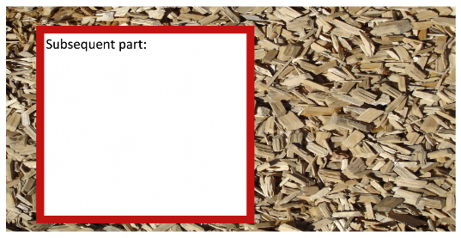
Our cooperation system (3/3) – prototype
Marker for searcher (show next parts)
Marker for builder (show steps to assemble)

Slide 5
Concepts for this cooperation system
Social interaction and coordination tool
properties of parts in the list of next parts
Roomware
Awareness
All parties are always aware of the progress and the actual following task
transparency of bricks in model to show progress
Synchronous bidirectional communication support
Co-located (AR shared space)
In general a symmetric system design (Exploring, working on the same content, build/assemble the furniture together (teamwork))
Can also be used in an asymmetric scenario (Helper-Expert)

Slide 6
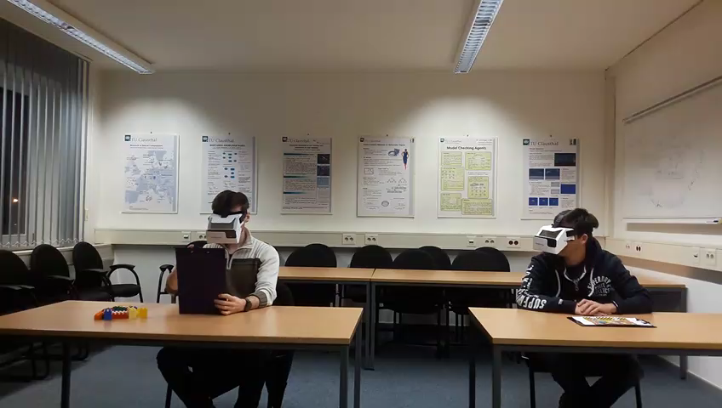
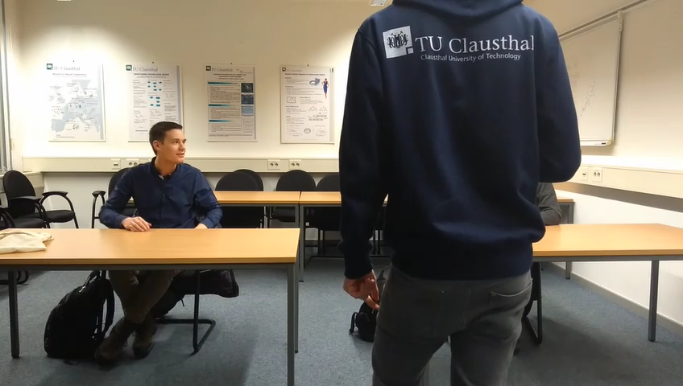
Evaluation
user studies
Questionnaires
Time measurement
AR supported manual
Normal manual
Different orders of execution
AR first / Normal first
Kirkpatrick Model
Reaction – Do the users need this support?
Learning – Can users work better together to build their furniture?
(Transfer)
(Results)

Slide 7
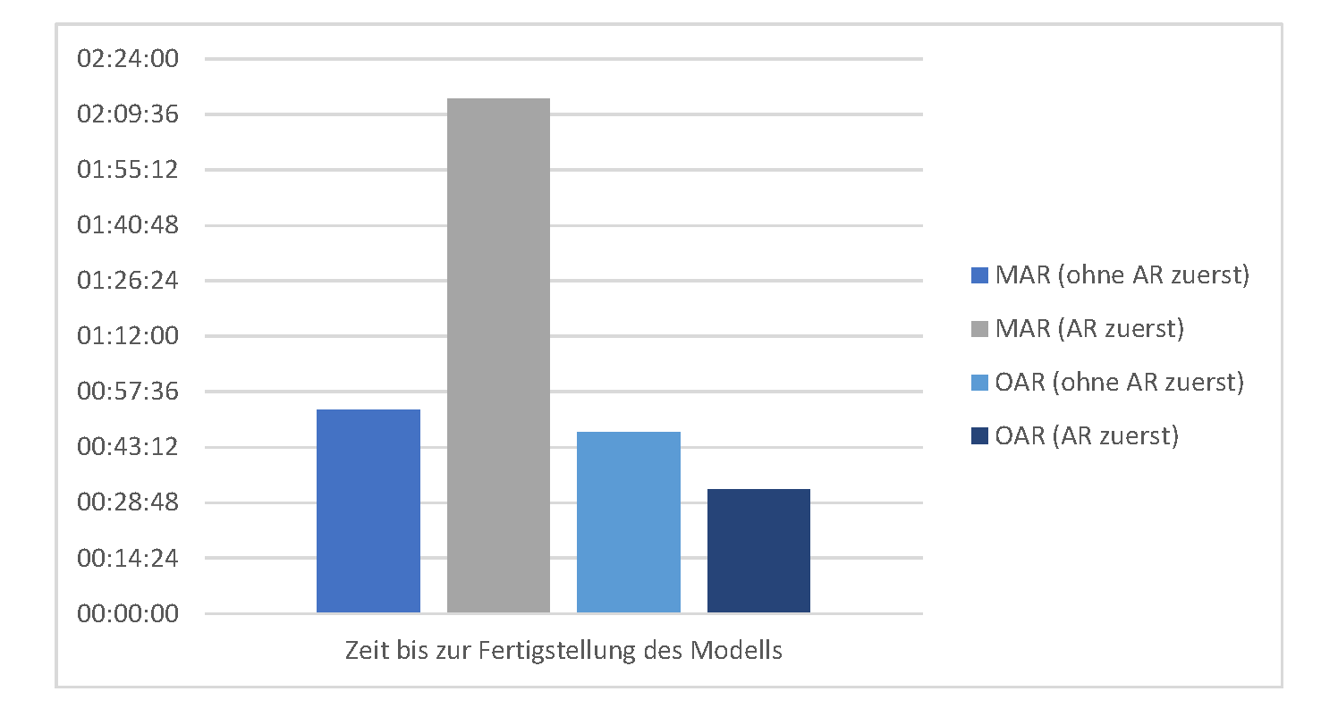
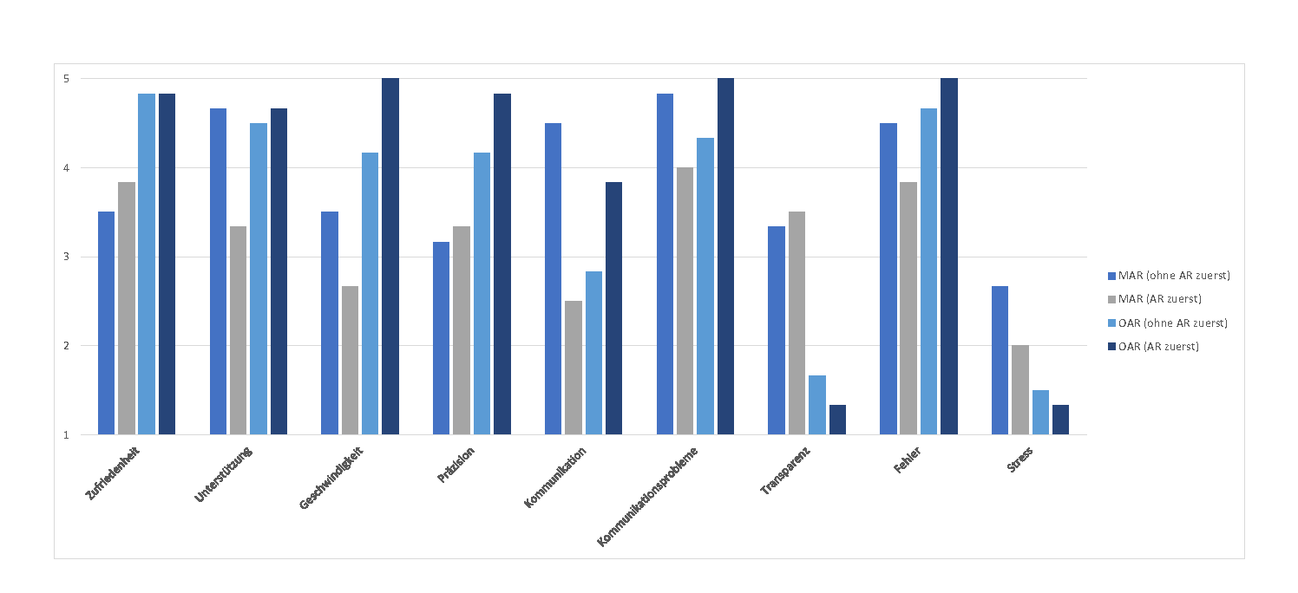
Evaluation Results (1/2)
Without AR building is faster
The users need time to get to know the technology and how to use it
The users feel more comfortable without AR
AR brings awareness and transparency

Slide 8
Evaluation Results (2/2)
System is difficult to understand at first
Minimize communication between partners
Different opinions
this reduces the fun during building
makes following the manual more efficient and straight forward
Acceptance of the system depends
Different use cases result in different acceptance

Slide 9
Are there any questions or further comments?

Slide 10
Prototype of group 8
Usage of AR Core (different technology)
better tracking compared to Vuforia
Difficult to build because video screen fills the viewport
Missing relation to first prototype
Helping with tutorials
Build a cube, not operating a washing machine now
Missing cooperation (in evaluation -> just one view of the initial system)

